Slide 1
SUICIDES IN INDIA
Karicharla GNV Swamy Naidu
11811841, B.Tech ,CSE
INT217
DATA MANAGEMENT PRESENTATION
&
Data Analysis

Slide 2
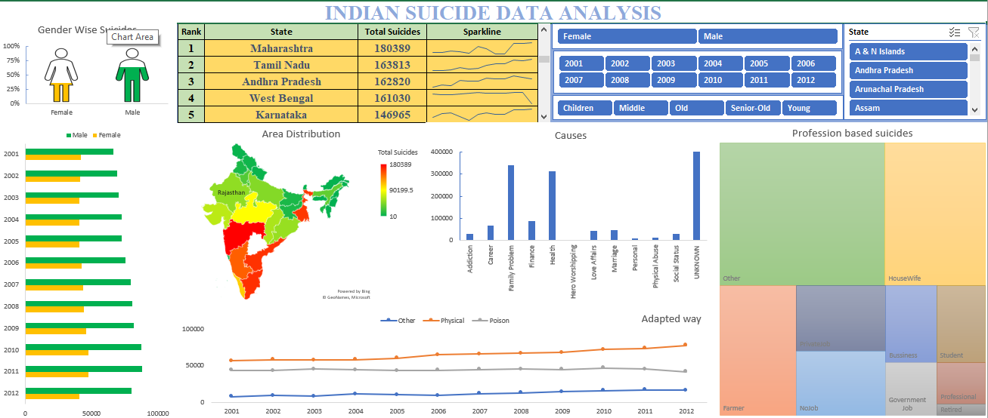
Dashboard

Slide 3
Suicides over years based on profession
In this analysis, the chart shows the partition of total suicides based on profession in a tree map. tree map is a basic graphical visualization that shows the share of each profession and can be easily compared with other. For the slicer I connected different tables using power pivot and have filers based on Gender, Age Group, Year, and state
Analysis Result
When we compare Both male and female together, the victim’s professions are unidentified, and later there are more housewives who committed suicides and later farmers in third place Compared in Male, there are more victims whose profession is unknown. After Farmers are the one who committed more suicides Compared in Female, there are more victims in Housewives, after others

Slide 4

When compared both Gender

Slide 5
Which way victims are adapting the most?
In this analysis, the chart shows the trend of total suicides based on means adapted in a line graph. Line graph is a basic graphical visualization that shows the trend over years or anything and can be easily compared with other for rise and loses. For the slicer I connected different tables using power pivot and have filers based on Gender, Age Group, Year, and state
Analysis Result
From this analysis we came to know that major part of victims belongs to physical means for all age groups and genders, and physical harming cases are raised from 2001 to 2012 as like other

Slide 6
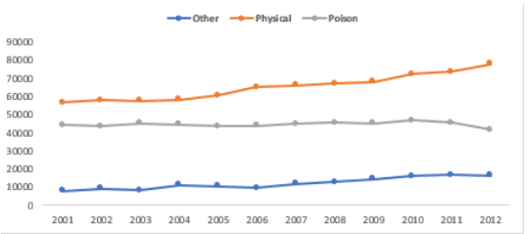

Slide 7
Which causes/reason leads to more suicides?
In this analysis, the chart shows the bar graph based on count of causes of a suicide. Bar Graph is a graphical visualization that is used to compare between items or anything and even can be used when we want to compare an item over a period of time. For the slicer I connected different tables using power pivot and have filers based on Gender, Age Group, Year, and state
Analysis Result
From this analysis we came to know that there are many causes for suicide in which unknown cause occupies the first place whereas family problems, marriage and love affairs comes next and hero-worshipping stands at the last. When it comes to male and female again the cause gets changes, for female health, marriage and family problems occupies the major part and for male health, family problems and social status occupies major part than unknown

Slide 8
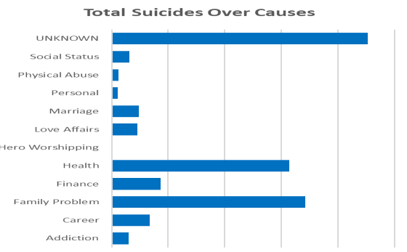

Slide 9
Trendline to show suicides on years for every state
In this analysis, this is a leader board build in cells and sparklines to show the state performance in a state individually and can tell whether the suicides increase or decreases for a particular state. For the slicer I connected different tables using power pivot and have filers based on Gender, Age Group, Year, and state
Analysis Result
From this analysis we came to know that Maharashtra stands at the first place in India with total 180389 cases for both male and female and this graph is being increased from 2001 to 2012 whereas Tamilnadu with 163813 cases occupies the second place next comes Andhra Pradesh with 162820 cases and next West Bengal with 161030 cases and Karnataka with 146965 cases. When it comes to female west bengal occupies the first place with 69299 cases and its graph being decreased from 2001 to 2012, second place is occupied by tamilnadu with 61324 cases and next comes Maharashtra with 58635 cases. In male suicide cases Maharashtra stands at the first place with total 121754 cases , it's graph being increased from 2001 to 2012 and Andhra Pradesh stands at second place with 108424 cases, Tamil Nadu at 3rd , Karnataka at 4th place and west Bengal stands at 5 the place

Slide 10
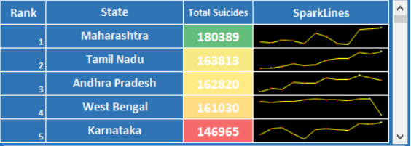

Slide 11
Trendline to show suicides on years for every state
In this analysis, the total no of suicides is represented graphically on the geo-graphical map. This type of graph is used when we have to represent numbers for a specific Geo location. For the slicer I connected different tables using power pivot and have filers based on Gender, Age Group, Year, and state
Analysis Result
When compared both male and Female, the southern states like Maharashtra, Andhra Pradesh, Tamil Nadu, West Bengal have more suicides. And northern states like Jammu, Himachal Pradesh, Punjab Has Least. When compared in children, West Bengal has Higher suicides and in Young Aged People, Maharashtra tops the rank. The senior aged and older people the figures have not much change as compared to all age groups

Slide 12
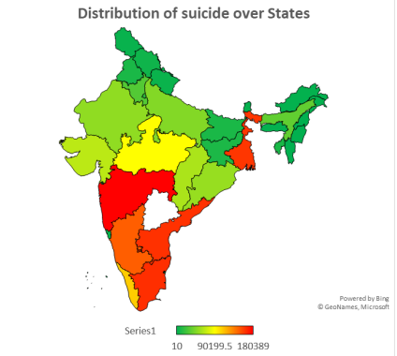

Slide 13
Trend over genders over years?
In this analysis, the chart shows the bar graph based on count of causes of a suicide for each gender. Bar Graph is a graphical visualization that is used to compare between items or anything and even can be used when we want to compare an item over a Period of time. For the slicer I connected different tables using power pivot and have filers based on Gender, Age Group, Year, and state
Analysis Result
From this analysis, we can clearly state that male has 2 times more suicides than female suicides and the suicide cases slightly increases from 2001 to 2012

Slide 14
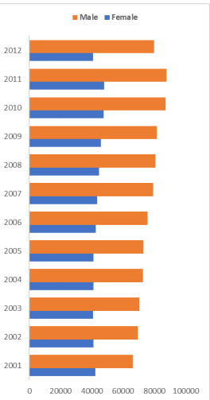

Slide 15
List of Analysis with results
Nearly Male victims of suicides are 2/3 of the total suicides
25% of the suicides are committed by people of Young aged (15-29) from the states Maharashtra, Madhya Pradesh, West Bengal, Gujrat, Andhra Pradesh, Tamil Nadu, Karnataka.
Most people are adapting the suicide by poison compared to all separately and physical when compared all physical harms
Housewives are committing suicides in Female and number of suicides in children are as students
More number of suicides occurred in 2011 in between 2001 to 2012
Health, Career, and Family Problems are the top three reasons for committing suicide
West Bengal has More children suicides
Retired people are less Likely to cause Suicide
Maharashtra has high number of suicides as Maharashtra has larger in area than others

Slide 16

Thank You

